Slide 1
CMU 10-742 Machine Learning in Healthcare
Lecture 3: Risk Stratification
Adam Berger

Slide 2
Course Logistics
Assignment 0 is DUE on Thursday (Sep 5)
Assignment 1 is DUE next Thursday (Sep 12)
Final Project proposal (Milestone 1) due Oct 10

Slide 3
Final Project
Milestone 1 (Oct 10; 3 points): Submit 1-page project proposal, which describes the problem you are addressing, a brief outline of your approach, and the data you intend to use.
Full credit requires:
Meet the deadline
Do not exceed the length limit
Proposed project adheres to requirements
You receive approval from course staff. You may receive approval right away, or we may ask you to revise your proposal.
Feel free to submit your proposal earlier than Milestone 1!

Slide 4
Final Project
Milestone 2 (Nov 7; 3 points): Submit 1-page progress report, describing work completed and pending.
Full credit requires:
Meet the deadline
Do not exceed the length limit
Provide meaningful detail on your progress

Slide 5
Final Project
Milestone 3 (Dec 3; 19 points): Poster session / live demo. Submit your poster as a pdf within Canvas before the poster session.
Projects evaluated on:
- problem definition
- implementation and technical rigor
- details on data handling ("Table 1" as described in lecture 6)
- presentation of results
- discussion and considerations for future work
Suggested poster template: https://drive.google.com/drive/u/1/folders/16tSJGJryd7NgQCBblaKxTfXLZXDIJJrt

Slide 6
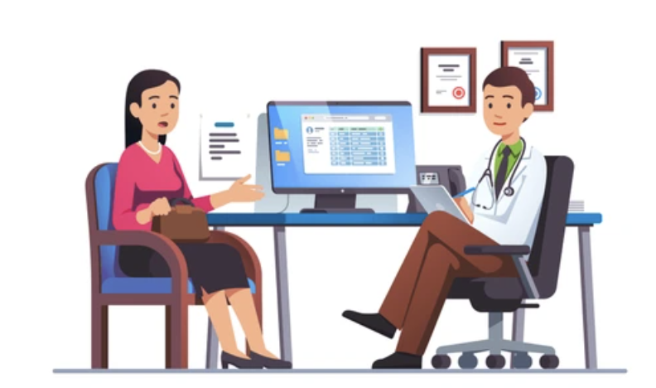

Who Codes? Where? Why?
1. Providers delivering care to a patient
2. Medical coders preparing to submit claim to insurer
Goal: accurately document patient’s condition, treatment, and procedures. Make it easy for the next clinician who treats this patient. Facilitate reporting, quality control, and research.
Goal: get paid correctly, promptly, and maximally.

Slide 7
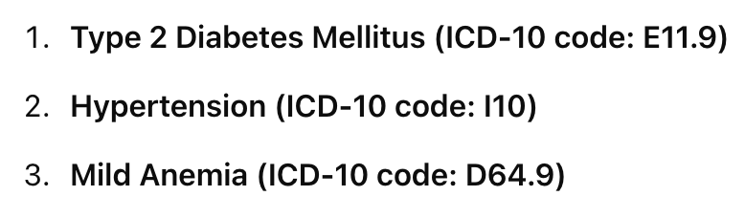
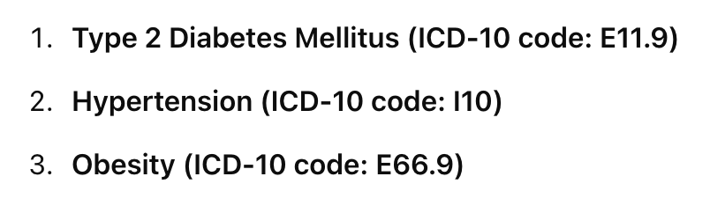
Coding Output Often Diverges
Scenario: Jeff visits Dr. Cruz for an appointment. Jeffrey has Type 2 Diabetes and Hypertension. During the visit, Jeff also mentions that he’s been fatigued lately. Dr. Cruz diagnoses Jeff with Mild Anemia. Dr. Cruz also notices that Jeff’s Body Mass Index (BMI) is elevated.
Dr. Cruz uses these codes in the EHR:
Medical coder uses these codes in the claim:
Don’t bother adding obesity – not the primary focus of visit.
Don’t bother adding anemia–unrelated to any care delivered during visit. Did add obesity - Including this dx may justify a higher level of care.

Slide 8

Notes:
medical coding a huge industry

Slide 9
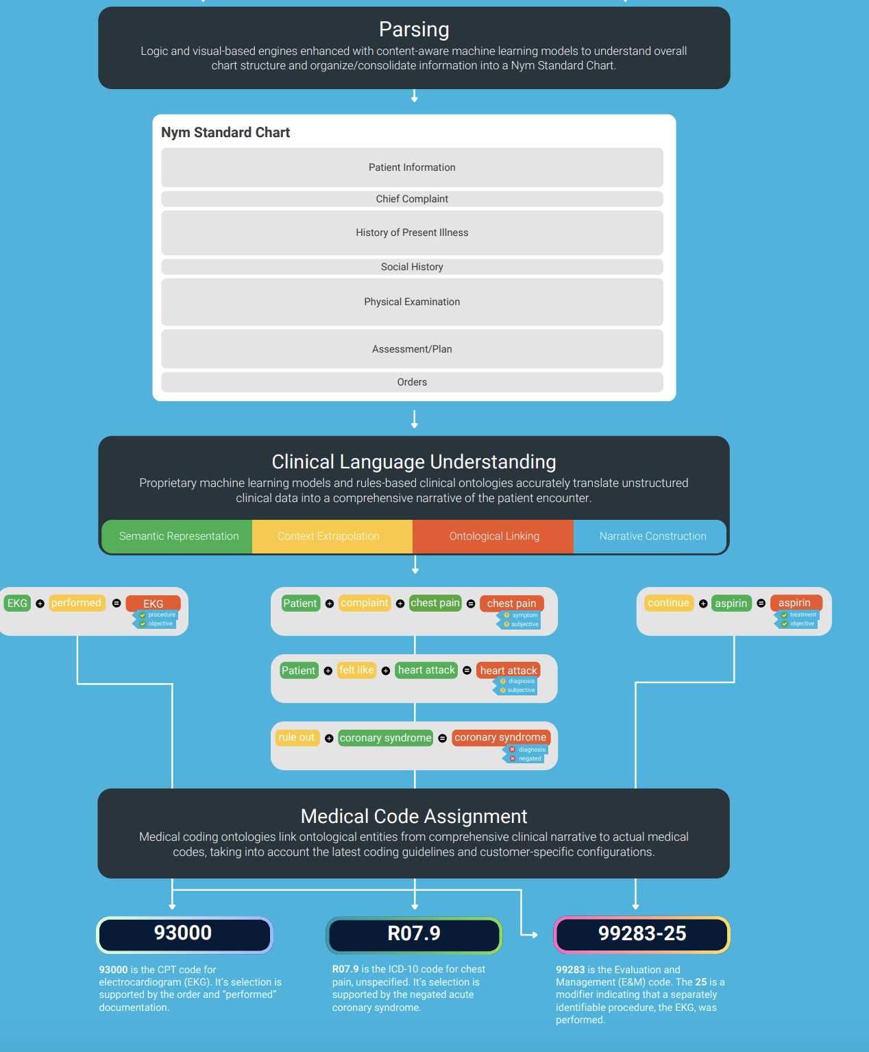
AI-Powered Coding
“Computer-Assisted Coding” or “CAD”
https://aviaconnectcontent.s3.amazonaws.com/f68a2971-5112-4581-8c9d-666d2b18b185

Slide 10
Today
What is Risk Stratification?
Let’s use ML!
Some Gotchas
Risk Adjustment

Slide 11
What is Risk Stratification?
Split patient population into low risk and high-risk groups
Notes:
Or more generally, *tiers* of groups.
NOT diagnosis
NOT prognosis

Slide 12
Risk stratification outside healthcare?
Notes:
- car insurance
- banking – credit 4 credit card
- law enforcement – where to have police spend time patrolling

Slide 13
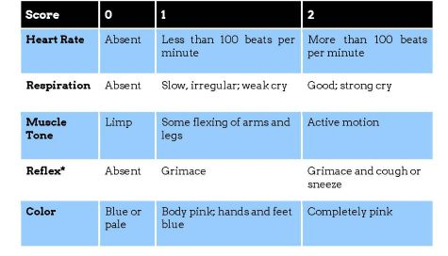
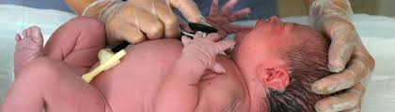
‘Classic’ Risk Stratification (1)
APGAR (1952)
https://www.merckmanuals.com/professional/multimedia/clinical-calculator/apgar-score
Notes:
Why do you think this has been around for 70 years?
Good: simple, reliable, explainable, low # of inputs, predictive (c-statistic = AUROC = 0.8 for predicting neonatal mortality – not bad!).
Some researchers have proposed more refined scores but they don’t perform much better and require a lot more inputs

Slide 14
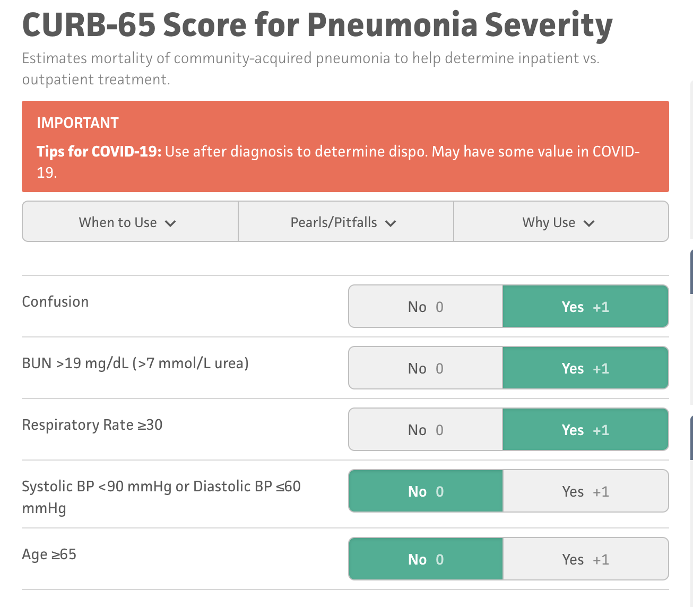
‘Classic’ Risk Stratification (2)
https://www.mdcalc.com/calc/324/curb-65-score-pneumonia-severity
Notes:
BUN = blood urea nitrogen – high -> dehydration
Other examples?
cancer staging
GAD-7 (anxiety),
PHQ-9 (depression)
Framingham risk score (cardio)
BI-RADS (Breast Imaging-Reporting and Data System): (0-6, higher = more chance of malignancy)
Why Risk strat scoring???
- how to care for a single patient
- pop health - how to allocate care to entire population

Slide 15
Shortcomings of Classic Risk Stratification
Weights are hand-crafted
Can’t easily tune/adjust
Can’t handle missing data
Manual assessment; requires clinician time/attention

Slide 16
Today
What is Risk Stratification?
Let’s use ML!
Some Gotchas
Risk Adjustment
Notes:
2 case studies

Slide 17
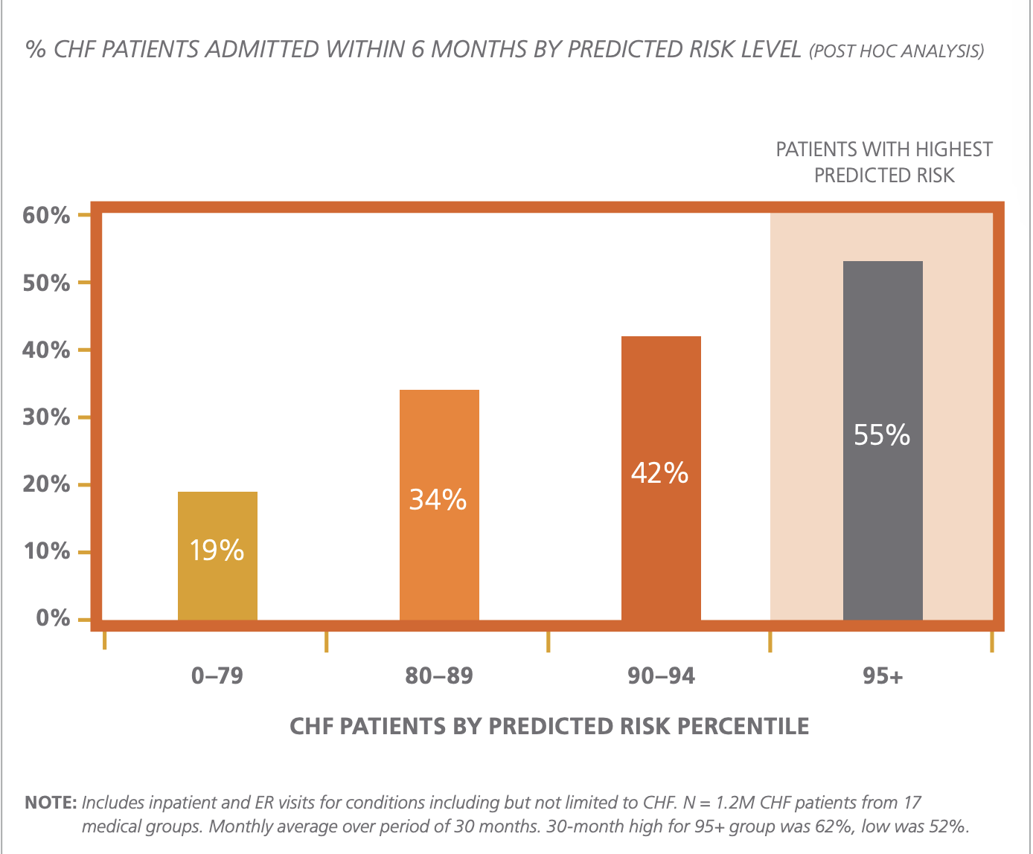
Example: Congestive Heart Failure (CHF)
https://www.optum.com/content/dam/optum/resources/whitePapers/7973_WhitePaper_PredictiveAnalytics.pdf
Notes:
real-world risk-strat algorithm
Optum built model to look at a patient’s EHR data and predict likelihood of imminent admission for CHF. PURELY PASSIVE AND RETROSPECTIVE.
What is chart saying?
55% of top 5% most risky patients (flagged by algorithm) ended up in the hospital within 6 months (high precision)
How might you use this?

Slide 18
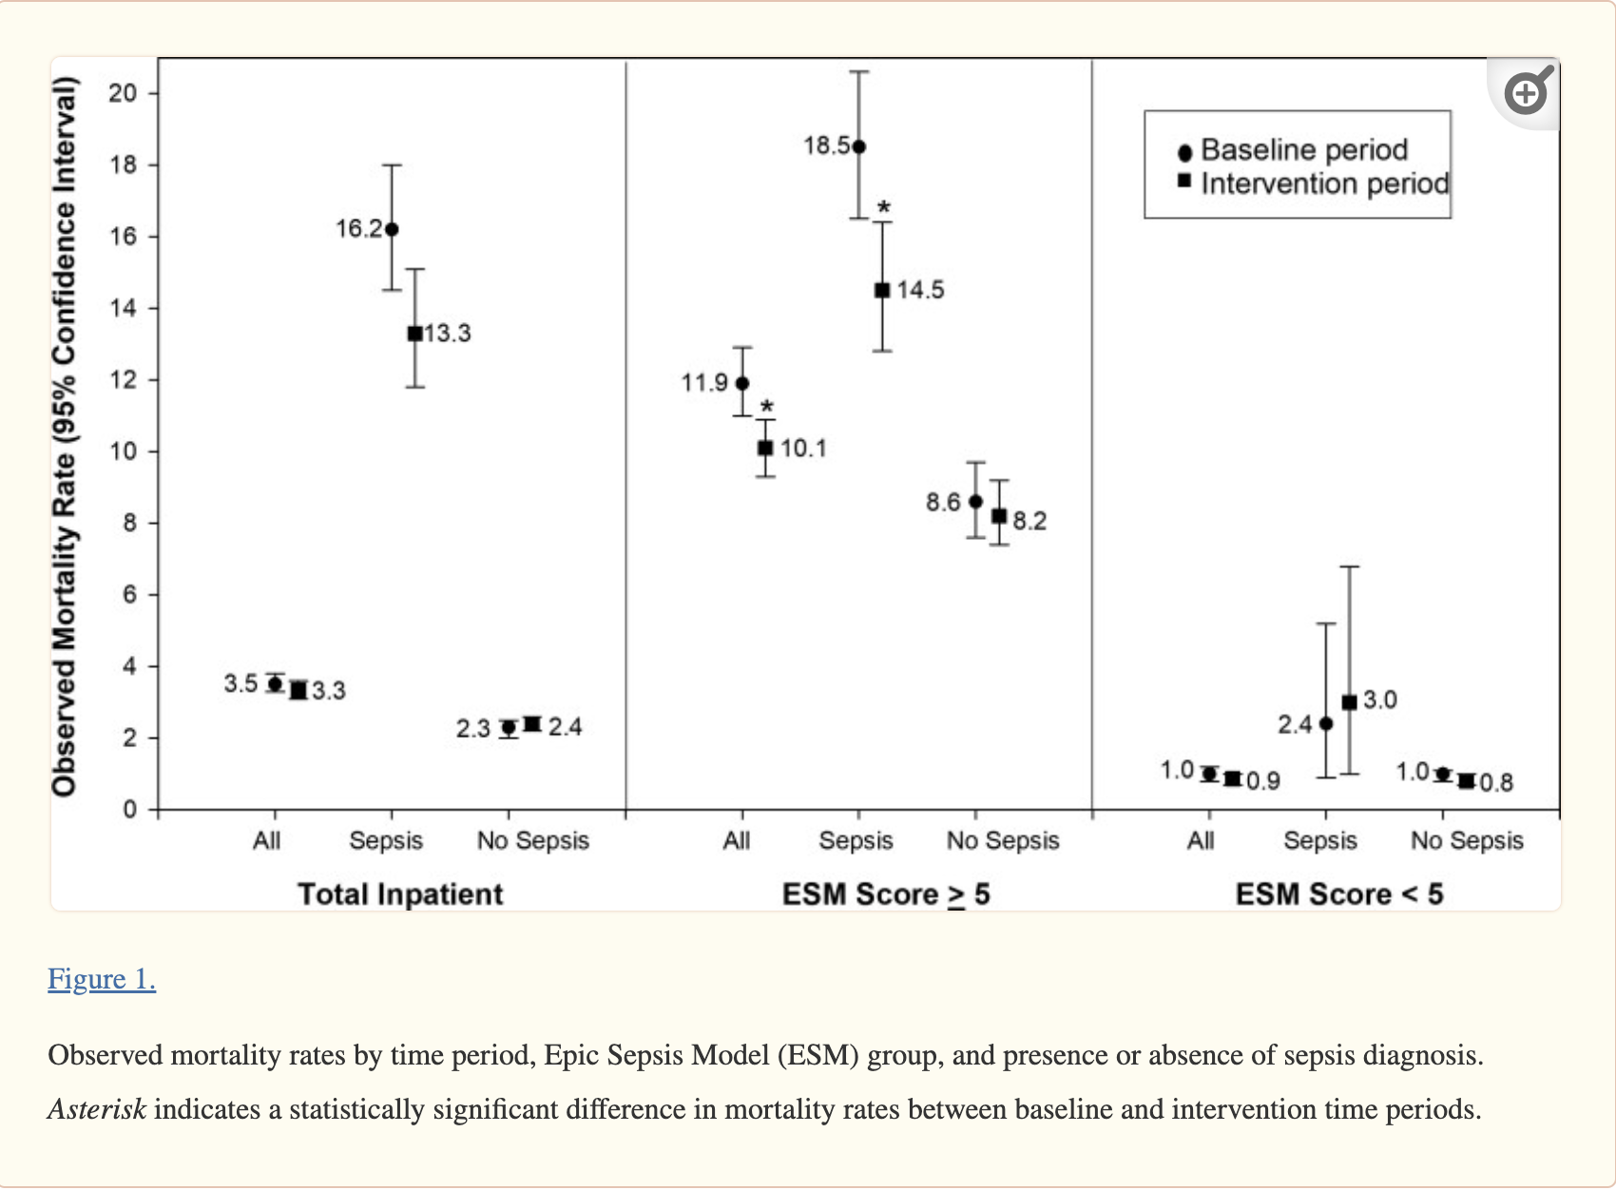
Example: EPIC Sepsis Module
https://www.ncbi.nlm.nih.gov/pmc/articles/PMC10317482/
Notes:
EPIC – industry dominant EHR vendor
EPIC use ML to predict which sepsis patients are high risk
Sepsis – dangerous, potentially fatal reaction to infection
ESM score with threshold=5 performs well in splitting sepsis cohort into low-risk and high-risk groups.
Why might this be useful in clinical practice?
Baseline period: ESM score not visible to clinicians. Intervention: alerts turned on.

Slide 19
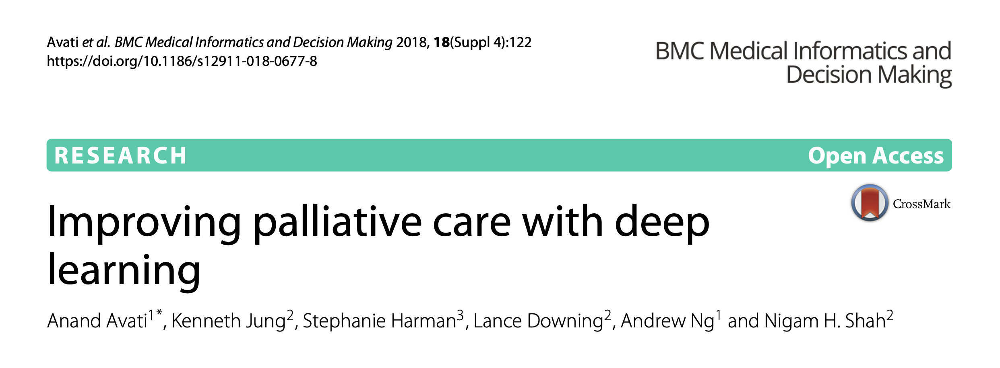
Example: Improve Palliative Care
https://www.ncbi.nlm.nih.gov/pmc/articles/PMC6290509/pdf/12911_2018_Article_677.pdf
Notes:
People want to die at home, but no one has these hard conversations until it’s too late
Can we figure out when someone is very likely to die in the next 6 months, so we can make sure to have that conversation

Slide 20
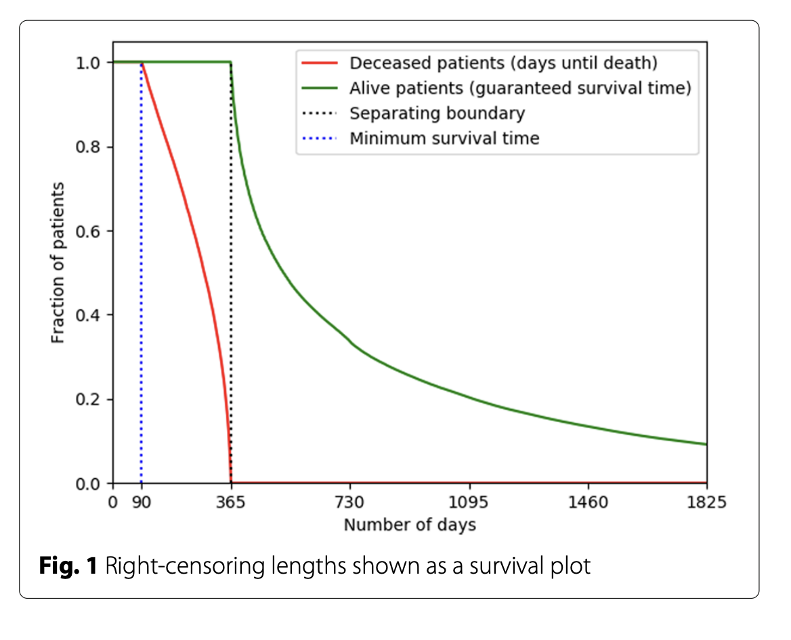
Predict the mortality of patient (yes/no) occurring within 12m, using EHR data of that patient from the prior year.
Notes:
Binary classification problem. Supervised learning. Retrospective EHR data.
Here: Kaplan Meier curve (will discuss!) – showing how we classified the patients
At t=0, can we classify a patient as green or red?
After training, run the model for inference every night on all patients in hospital, send list of highest-scoring patients to palliative care team

Slide 21
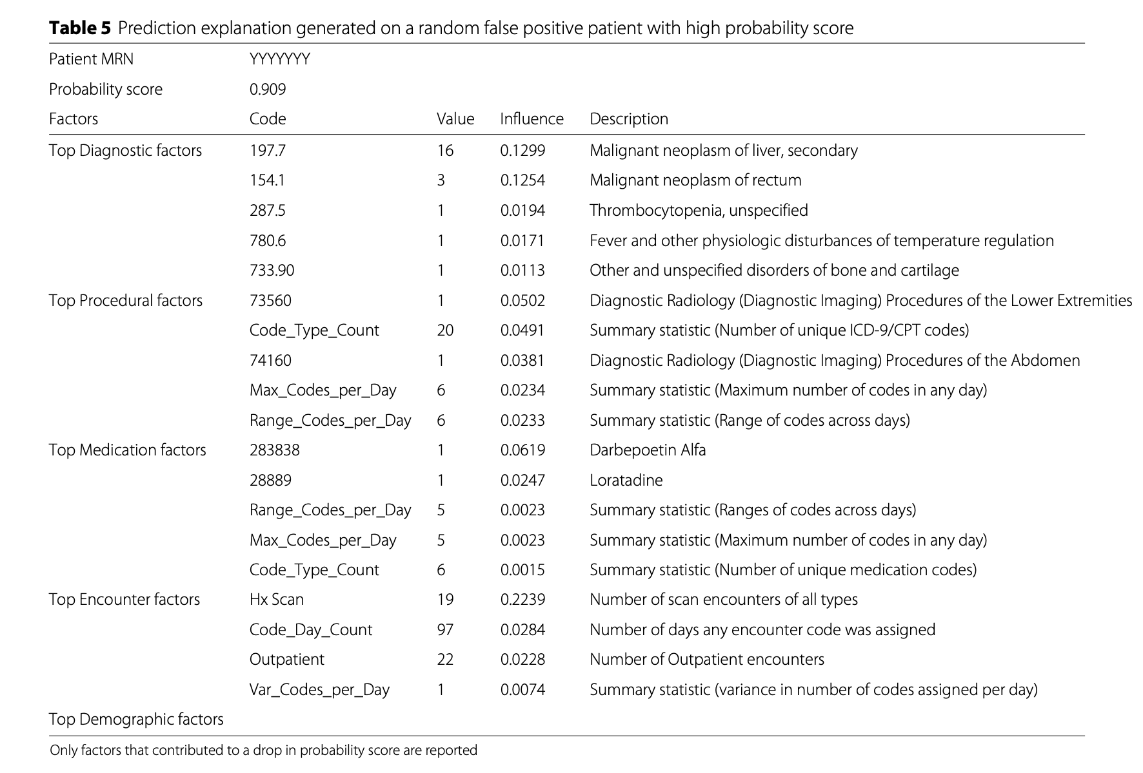
Notes:
Roughly 13k numeric discrete-valued features. Split last year observations into 4 epochs and have feature vectors for each epoch.
18 layer fully connected NN
Influence = drop in log-likelihood if you removed this feature weight (ablation experiment)

Slide 22

Wow – What an Improvement!
Old-Fashioned | ML-Powered
Screen patients manually | Compute score for entire population at once
Hand-crafted rules | Algorithmically selected features
Not optimal | (Locally) optimized cost function
Notes:
Optimal per whatever loss function (e.g. penalized log likelihood of data) you used

Slide 23

Notes:
ML actually introduces some new problems

Slide 24
Today
What is Risk Stratification?
Let’s use ML!
Some Gotchas
Risk Adjustment

Slide 25
Gotcha 1: Overparametrized Models
Notes:
Bias-variance tradeoff
If we’re worried about overparametrized/overfit models, is that too much bias or variance?
Bias = “too basic” (model too simple)
Variance = “too volatile” (overfit) <- this problem

Slide 26
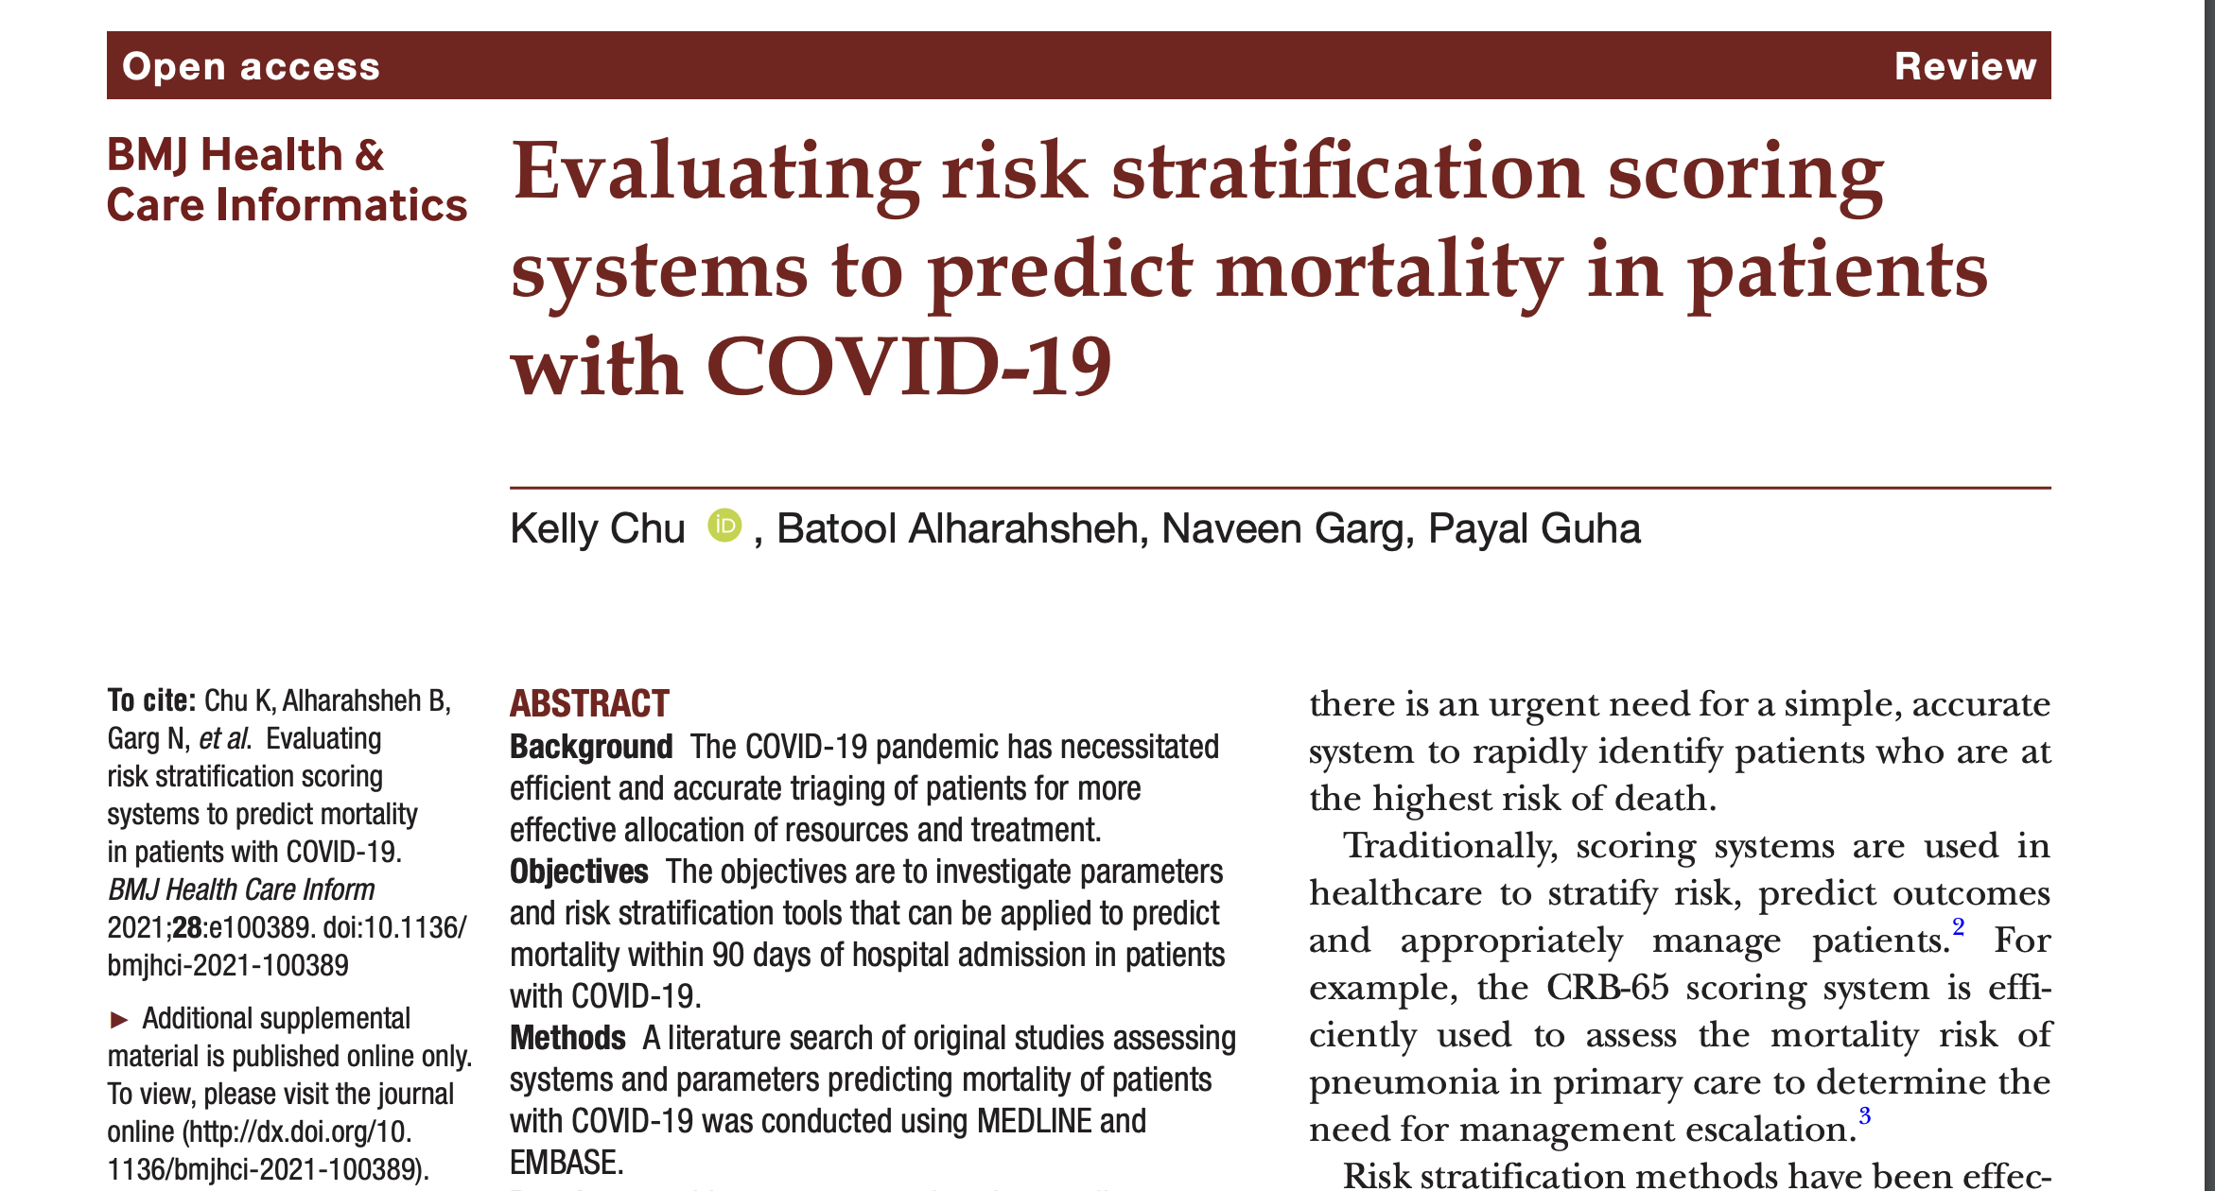
https://www.ncbi.nlm.nih.gov/pmc/articles/PMC8441221/#SP1
Notes:
Good literature survey paper that looked at all the studies that predicted C19 mortality

Slide 27
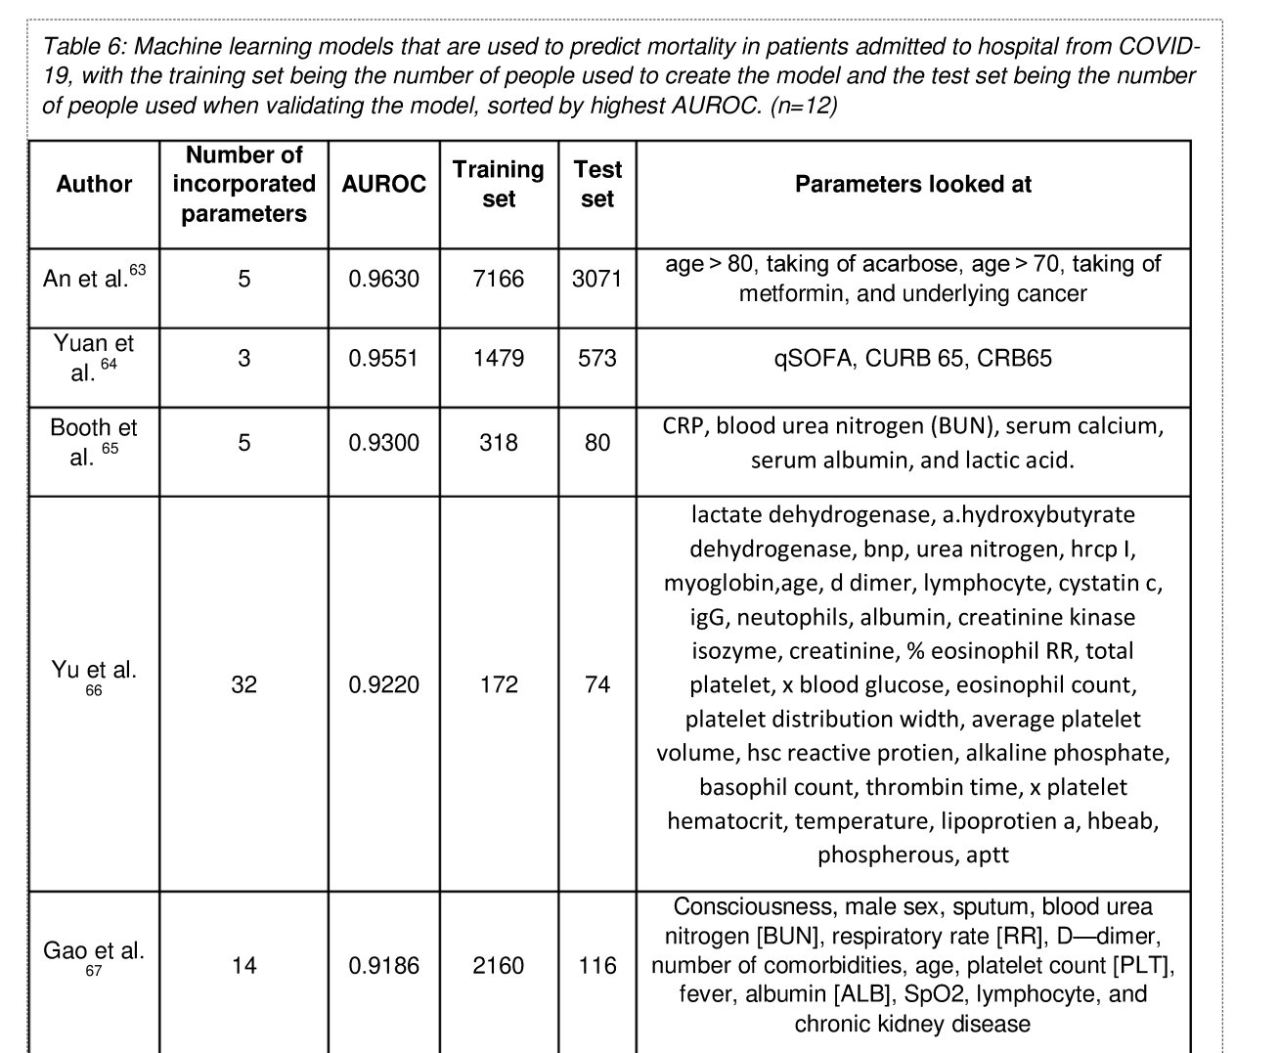
Notes:
Notice AUROC for the 3-param model outperforms the AUROC for the 32 param model.
“worst of all worlds” – poor performance and overparametrized
Huge asterisk – (1) self-reported (2) slightly different target definitions
Having said that, we can generally say:
For a given performance level, a sparse model >> a model w more features
What’s a sparse model? Why imp. n healthcare?

Slide 28
Regularization encourages smaller weights. L1-regularization encourages ‘sparse’ models

Slide 29
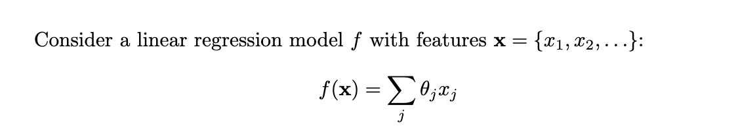
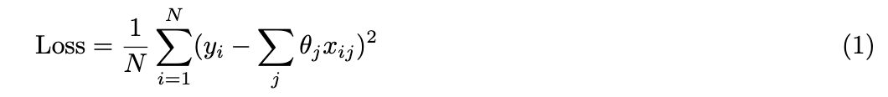
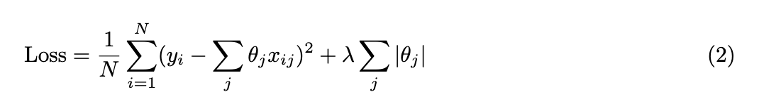

Slide 30
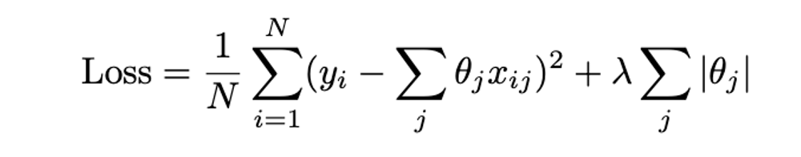
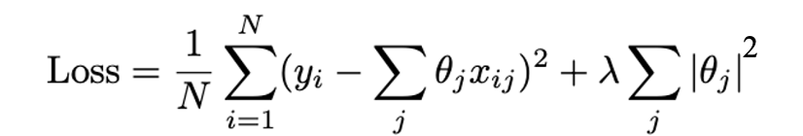
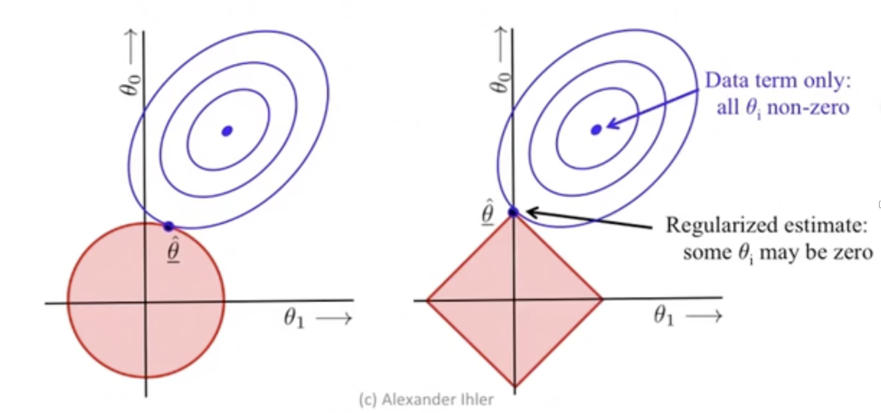
L1 Regularization Encourages Sparse Models
Visualizations from: https://www.youtube.com/watch?v=sO4ZirJh9ds

Slide 31
Gotcha 2: Leaky Labels

Slide 32
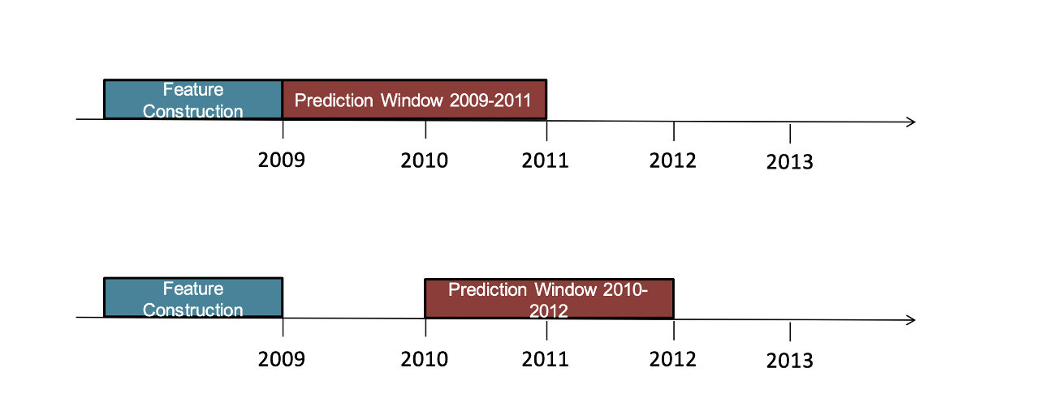
https://ocw.mit.edu/courses/6-s897-machine-learning-for-healthcare-spring-2019/resources/mit6_s897s19_lec4/
Notes:
Imagine we’re predicting whether a patient gets congestive heart failure and this is our setup.
Any possible issues?
Leaky labels: info from labels ‘leaks’ into the features (example: clinical prescribes lisinopril, an ACE inhibitor, used to treat CHF)
What’s a good way to avoid?
Imperfect/crude solution (losing potentially important data in the interstitital period?)

Slide 33


Contest: predict breast cancer from mammography data
Training data: 102,294 candidate images (623 positive)
Task: Rank images x by p(cancer|x)
In winning entry, the ‘patientID’ feature carried huge predictive weight.
https://www.researchgate.net/publication/225479889_Medical_data_mining_Insights_from_winning_two_competitions
Notes:
Spacing out the history and target doesn't always do the trick. Labels can leak in other ways than from the future to present.

Slide 34
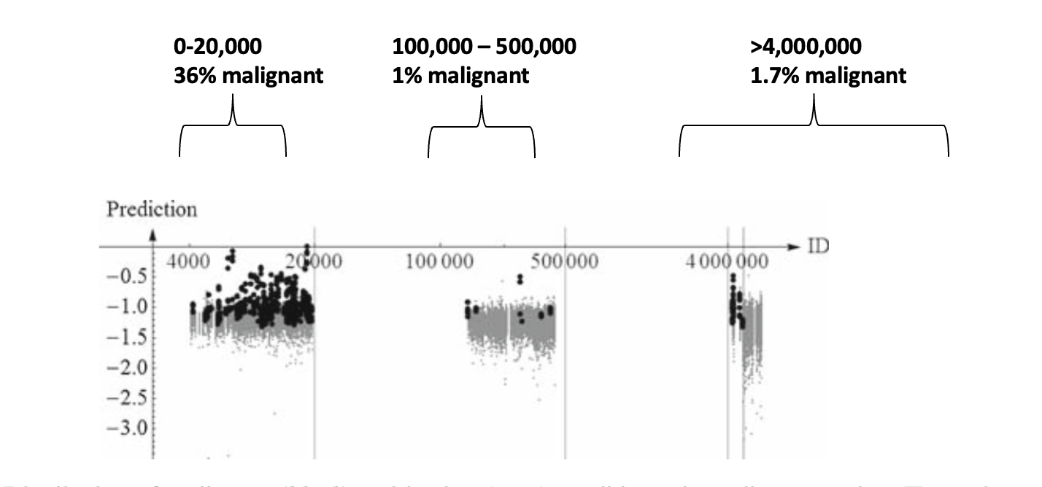
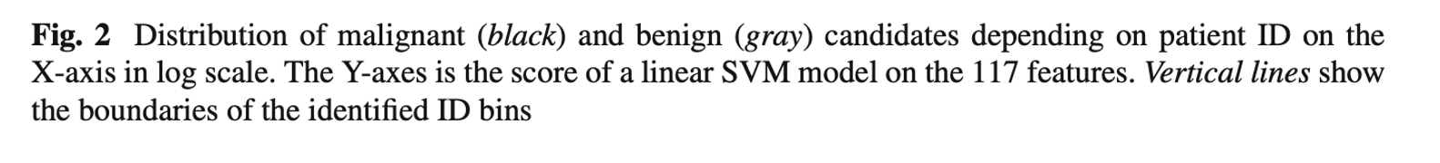
0-20,000 36% malignant
100,000 – 500,000
1% malignant
>4,000,000 1.7% malignant
Notes:
Authors couldn't understand why their model did so well. So they dug into the data
X-axis: patientID value
Black: malignant
Grey: benign
Possible reason?
(Different institutions? Some preventative, some cancer treatment center?)
What is this model going to learn?
How to fix?
LESSON: always inspect your features (somehow)

Slide 35
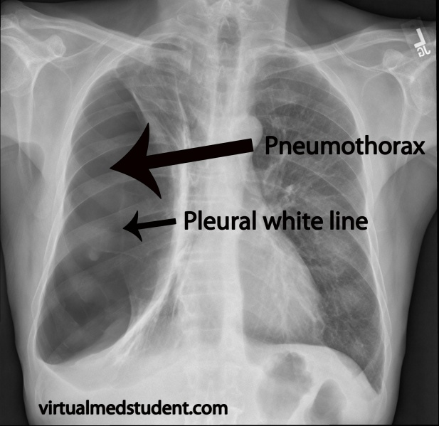
http://www.profcaseyscudmorern.org/chest-tubes.html
Notes:
Leaky labels in medical imaging
PTX = air pocket in lungs
Insert a drain
X-rays often have a drain in the image.
Why is this undesirable when building a CNN to classify PTX?
===
So how to avoid leaky labels?
(INSPECT YOUR DATA)

Slide 36
Gotcha 3: Non-Stationarity
Notes:
Who knows what this is?

Slide 37
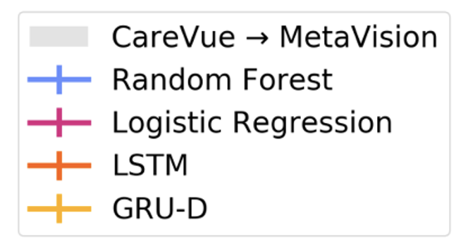
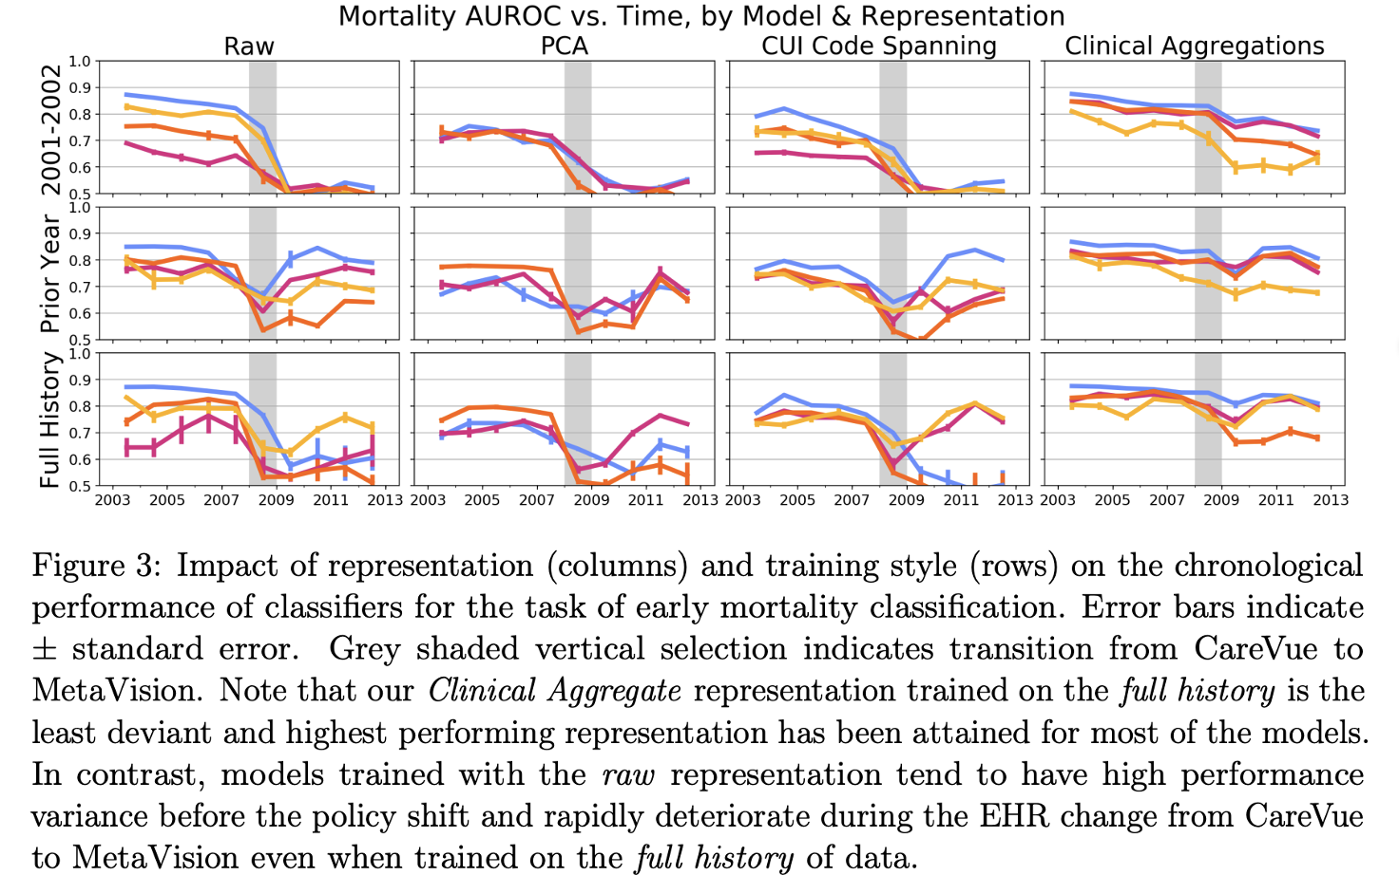
https://proceedings.mlr.press/v106/nestor19a/nestor19a.pdf
Notes:
MIMIC. 2009 switch from CareVue -> Metavision
bad thing and good thing
example: CareVue often used local coding systems for rx. MetaVision more frequently used rxNorm,/NDC
NB: Data can drift across time, institutions, geography, etc.
MIT course – entire lecture on techniques to map data from one EMR to another

Slide 38
Gotcha 4: “Looking Over the Shoulder of Clinicians”

Slide 39
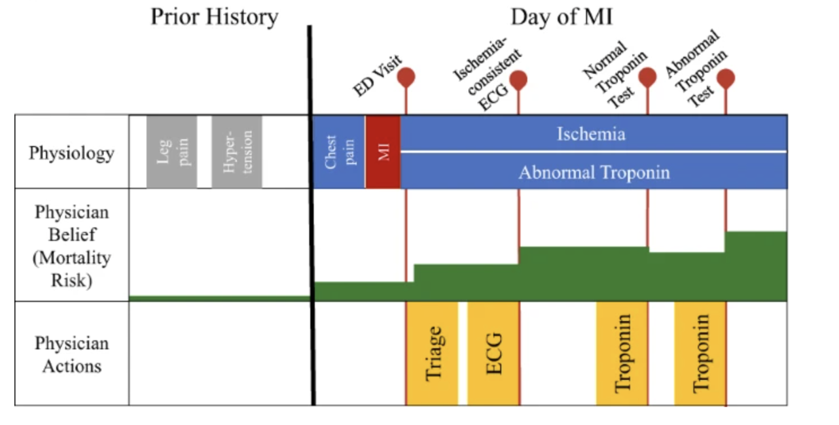
Notes:
Iimagine a patient who has an MI and winds up in the ED.
Ischemia = restricted blood flow
Troponin – a protein released into bloodstream when heart is damaged
Notice a few things:
physician belief around mortality risk changes as new data comes in
Misleading initial troponin test, physician belief declines
Phyisican beliefe around mortality does NOT change as they order tests (not should it)
Now let’s imagine building a model to predict MI. A physician ordering troponin is HIGHLY correlated to an MI – I bet you $1M that this would be a high-weight feature of any model

Slide 40

Notes:
We can certainly learn a model that says “A troponin test means MI is likely”.
But how would this be useful in clinical practice?

Slide 41
Conflating Correlation & Causation
Example scenario | Risk
(Patient doesn’t have the condition) Clinician orders a test. Test comes back normal. However, model assigns high risk based on test order. | Waste money on unnecessary extra lab tests/imaging
(Patient has the condition) Clinician orders test at 3AM. Test delayed to 8AM for IT issue. Model assigns low risk to patient. | Patient could die
Notes:
Why not just go ahead and use a model like this?

Slide 42
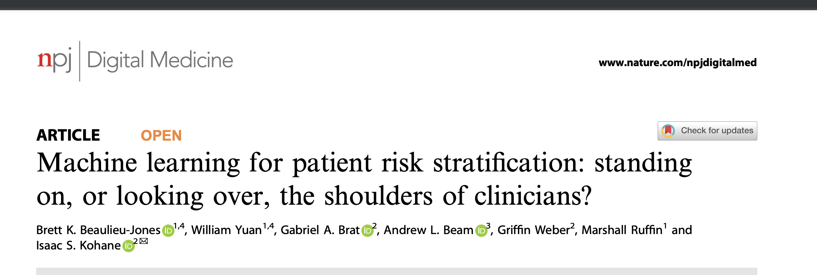
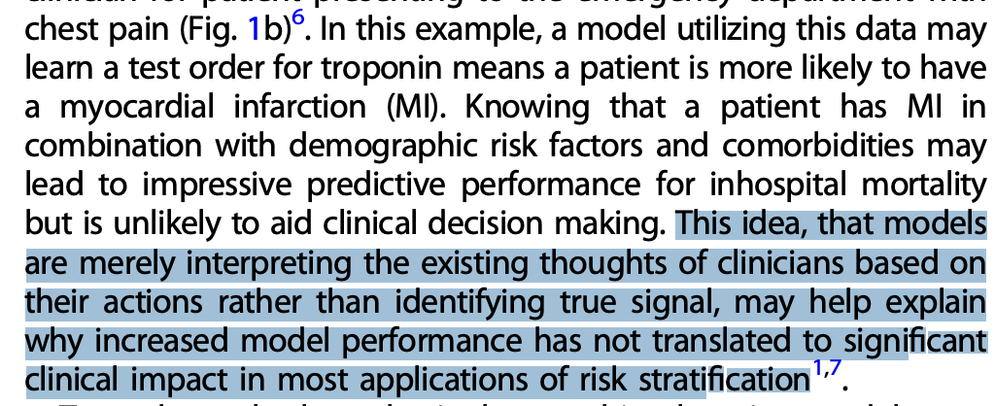
https://www.nature.com/articles/s41746-021-00426-3
Notes:
Sort of a sister paper to another paper we’re going to study in lecture 6, with some of the same authors
Try to measure how much these models are just ”looking over clinician shoulder”

Slide 43
Classifying EMR Data Elements
Clinician-Initiated
Test orders
rx
dx
Referrals
Consultations
Non-routine orders
Non-Clinician Initiated
Direct physiological measurements
Routine orders
Notes:
So how might you do this?
They classify EMR data into 2 buckets
Where would a lab test fit in?
Depends if it’s routine or not

Slide 44
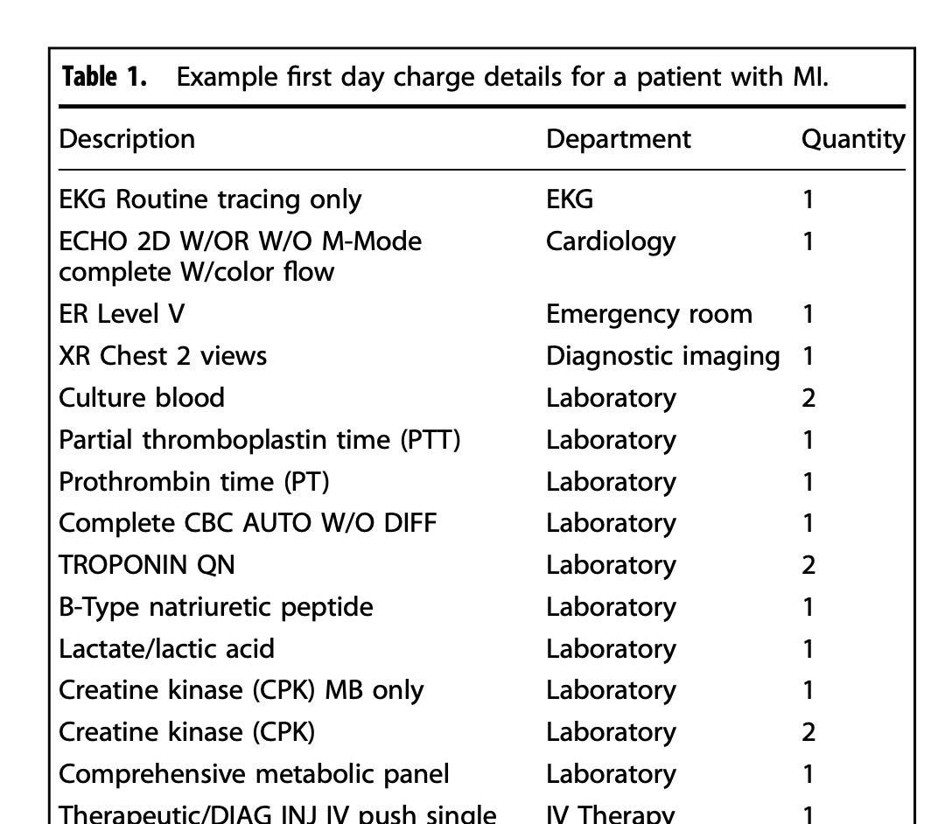
Notes:
Examples of clinician-initated actions here
“Charge details” – what clinicians billed for.
(Comprehensive metabolic panel arguably in the ‘routine’ category)

Slide 45
Bake-off with 4 Models
Demographics only: age, gender, marital status, insurance type
Upon Admission: Add referring source, admission type, admitting physician specialty, point of origin
Chargemaster: Add provider actions
EMR Baseline: state of the art published model
Notes:
Paper described an experiment w 4 models
Look at relative performance, should be obvious how much the clinician actions help
Anyone care to predict the results? Which model does the best? Second best? How close?

Slide 46
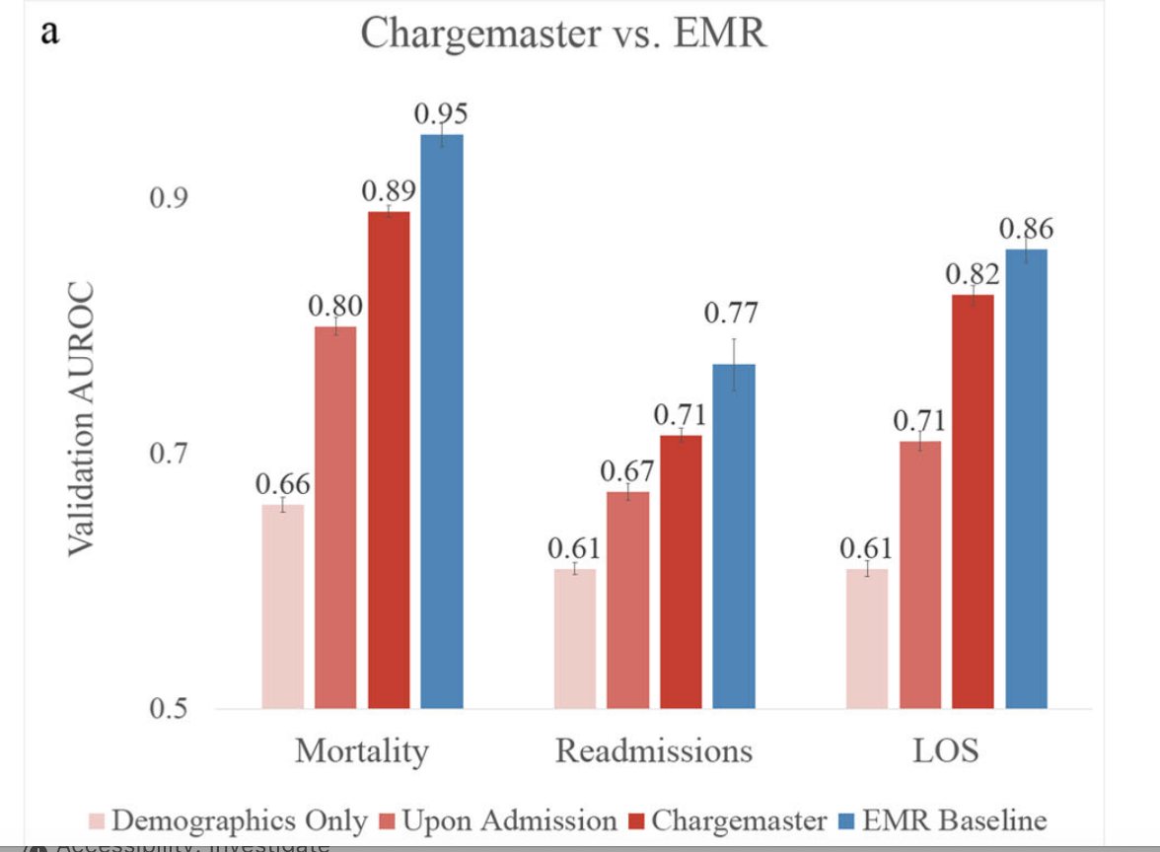
That’s pretty close!
Notes:
Notice the “chargemaster” model is near the EMR baseline!
What does that suggest about the EMR baseline?

Slide 47

How can you avoid just “watching over the clinician’s shoulder”?
Notes:
This was just to whet your appetite.
Core issue is that we want to model the causal drivers of the disease. Not confounders.
Later in course: causal analysis, confounders, etc.

Slide 48
Today
What is Risk Stratification?
Let’s use ML!
Some Gotchas
Risk Adjustment
Notes:
Now talk about an important application of risk stratification

Slide 49



Medicare Advantage (MA)
US Government (CMS) pays private health plans (e.g. Cigna) to insure Medicare members.
How should CMS reimburse Cigna for covering Mr. Jones?
$
$
Notes:
more about MA in an upcoming lecture
Average medical bills for a Medicare recipient in one year is (say) $24K
Should CMS just pay Cigna a flat $2000/person/month?

Slide 50
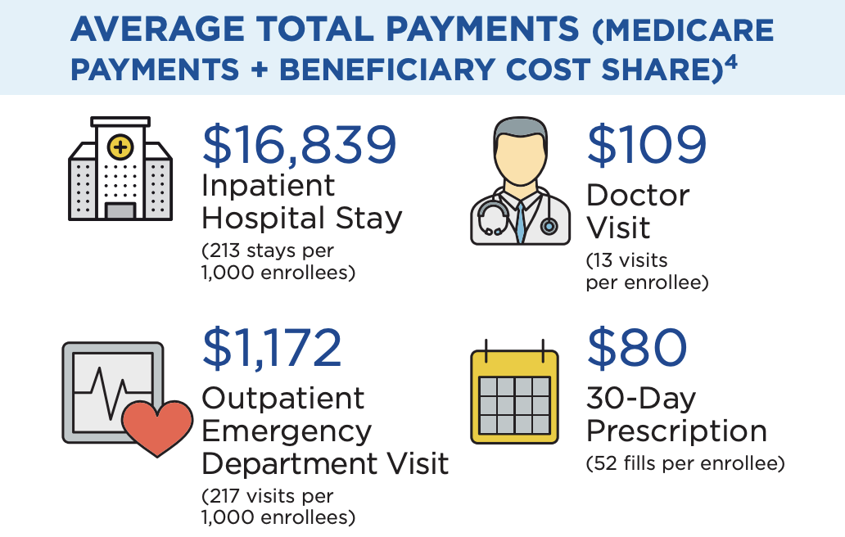
https://data.cms.gov/sites/default/files/2023-09/Medicare%20Beneficiaries%20at%20a%20Glance%20DY2021.pdf
Notes:
From CMS web site
Add these #s up, it’s proportional to what CMS should pay cigna to cover one person, right?

Slide 51
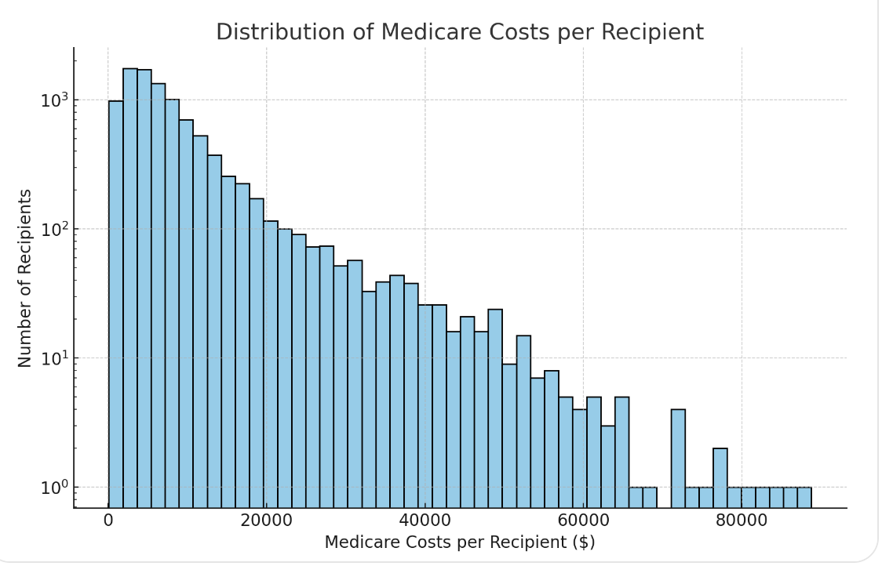
Per year
(synthetic but directionally accurate)
Notes:
But wait. The mean cost is important but it obscures the distribution. Not every Mericare beneficiary costs the same every year!
I’m an MA plan, I’m getting $2000/month per enrollee, I should do everything I can to get those on the left side of the curve.
Then what happens?
Average cost per beneficiary for remaining group is higher. CMS pays more per beneficiary.
Traditional Medicare becomes a ‘dumping ground’ for highest cost members
(This is synthetic, I had chatgpt generate it, but it’s probably close and structurally correct.)

Slide 52
Adverse Selection
Notes:
Economic terms we have so far
Adverse selection
Delegated risk
Principal agent problem
Tragedy of the commons

Slide 53
Q: How to avoid this?
A: Risk Adjustment
Notes:
How to avoid all MA plans chasing after the healthiest Medicare recipients?
Anwer: pay MA plans more for sicker patients (“risk adjustment”)

Slide 54

Worked Example
Jeffrey is a 72-year-old male Medicare beneficiary living in Asheville, NC who has Type 2 diabetes with complications and congestive heart failure.
Step | Adjustment | RAF Score
1. Initialization |  | 1.0
2. Demographic | 72 year old male | +0.416
3. HCC | Type 2 diabetes with complications (HCC 18) Congestive heart failure (HCC 85) | +0.318 +0.323
4. Sum |  | 2.057
5. Geography adjustment | base payment rate for Asheville NC is $800 | $800 * 2.057 = $1645.60
Notes:
To claim an HCC score for one of your beneficiaries, you need to have it documented in their medical chart that year. Even for chronic conditions like lupus or CHF which don’t go away.
This should look familiar – it’s basically a classic risk stratification algorithm

Slide 55
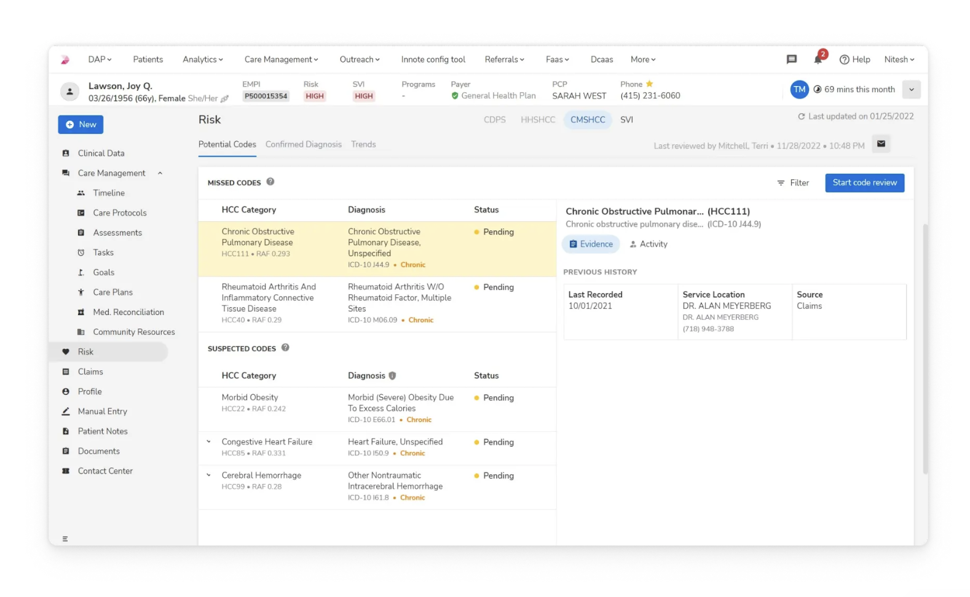
https://innovaccer.com/solutions/risk-adjustment
Notes:
Entire industry of solutions and vendors for maximizing HCC scores.
i.e. "properly risk-adjust your member population"
Home health assessments. Finding gaps.
$100B annually

Slide 56
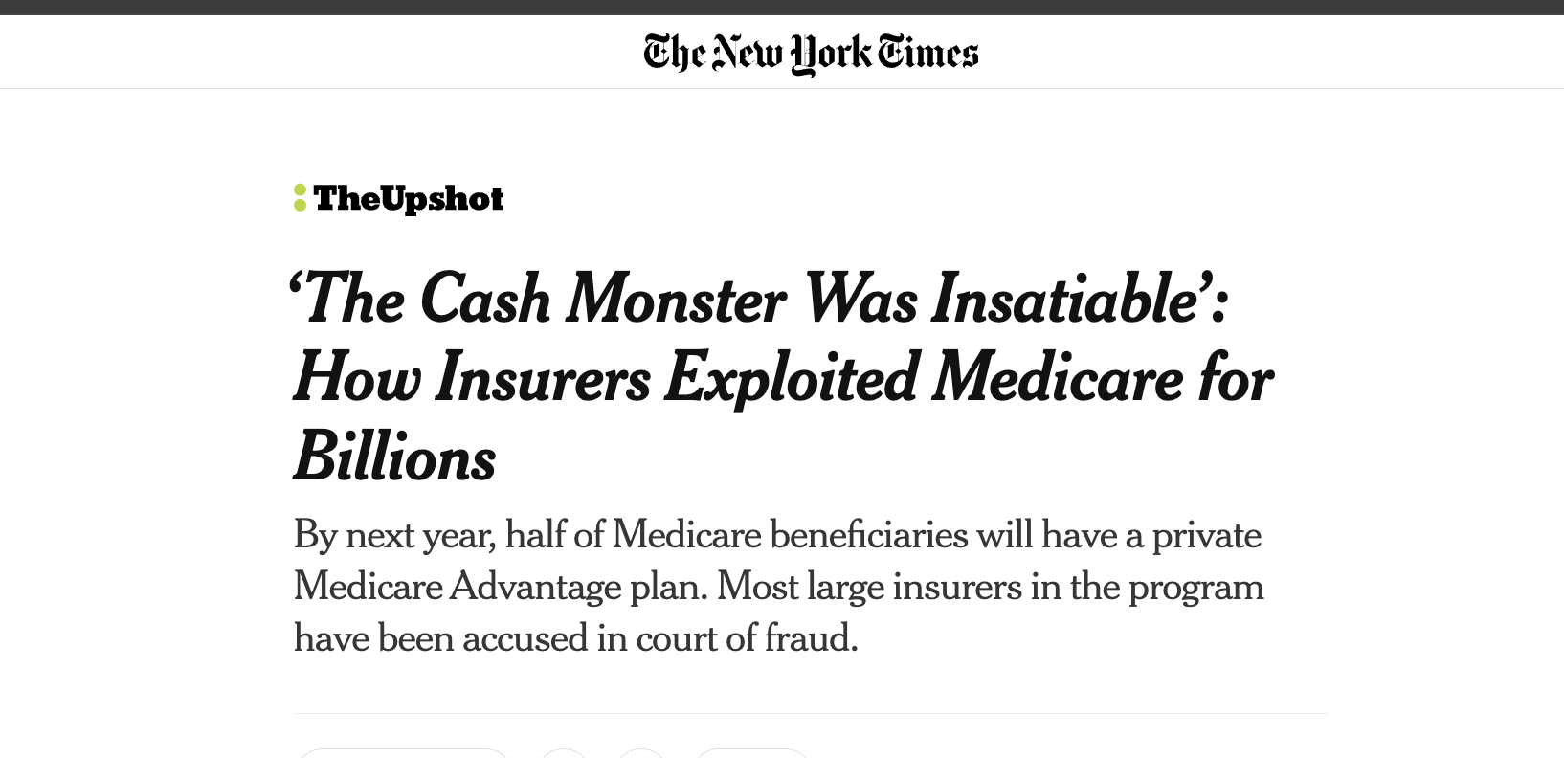
https://www.nytimes.com/2022/10/08/upshot/medicare-advantage-fraud-allegations.html
Notes:
CMS audits practices to make sure their billing (CPT codes) are backed by documentation and appropriate.
arms race:
ML for automatic coding.
ML for coding audits

